Slide 1
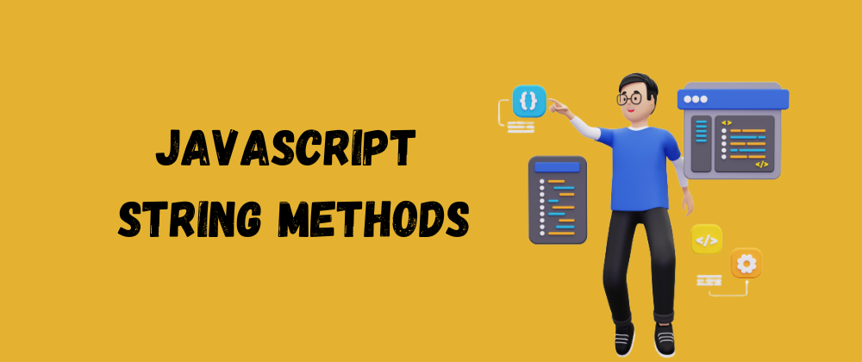

Slide 2
What we Cover Today:
01
02
String Methods
Exercise

Slide 3
String Methods
charAt()
The charAt(x) method returns the character at a specified index (position) in a string:
Example:
let text = "HELLO WORLD";
let char = text.charAt(0); // H
length
The length property returns the length of a String.
Example:
let text = "ABCDEFGHIJKLMNOPQRSTUVWXYZ";
let length = text.length; // 26

Slide 4
String Methods
trim()
The trim() method removes whitespace from both sides of a string
Example:
let text1 = " Hello World! ";
let text2 = text1.trim(); // Hello World!

Slide 5
String Methods
toUpperCase()
The toUpperCase() method that convert a string to upper case
Example:
let text1 = "Hello World!";
let text2 = text1.toUpperCase(); // HELLO WORLD!
toLowerCase()
The toLowerCase() method that convert a string to lower case
Example:
let text1 = "Hello World!";
let text2 = text1.toLowerCase(); // hello world!

Slide 6
String Methods
Chaining String Methods
Chaining = use many methods together on the same value.
We “chain” them with a dot (.).
The result of one method goes into the next method.
Example 1: Without Chaining
let text = " hello world ";
let trimmed = text.trim(); // remove spaces
let upper = trimmed.toUpperCase(); // make big letters
console.log(upper); // "HELLO WORLD"

Slide 7
String Methods
Chaining String Methods
Example 2: With Chaining
let text = " hello world ";
console.log(text.trim().toUpperCase()); // "HELLO WORLD"

Slide 8
String Methods
indexOf()
The indexOf() method returns the index (position) of the first occurrence of a string in a string, or it returns -1 if the string is not found:
Example:
let text = "Please locate where 'locate' occurs!";
let index = text.indexOf("locate"); // 7

Slide 9
String Methods
lastIndexOf()
The lastIndexOf() method returns the index of the last occurrence of a specified text in a string:
Example:
let text = "Please locate where 'locate' occurs!";
let index = text.lastIndexOf("locate"); // 21

Slide 10
String Methods
slice()
The lastIndexOf() extracts a part of a string and returns the extracted part in a new string.
The method takes 2 parameters: start position, and end position (end not included).
Example:
let text = "Apple, Banana, Kiwi";
let part = text.slice(7, 13);

Slide 11
String Methods
split()
The split() method that covert a string to an array
Example:
let text = “Khalid Abdirahman”
text.split(); // [“Khalid Abdirahman”]
text.split("") // [“K”, “h”, “a”, “l”, “i”, “d”, “ ”, “A”, …]
text.split(" ") // [“Khalid”, “Abdirahman”]

Slide 12
String Methods
includes()
The includes() method returns true if a string contains a specified value.
Example:
let text = "Hello world, welcome to the universe.";
text.includes("world"); // true
Example 2:
let text = "Hello world, welcome to the universe.";
text.includes("world", 12); // false
Note: includes() is case sensitive

Slide 13
String Methods
StartsWith()
The StartsWitch() method returns true if a string begins with a specified value.
Example:
let text = "Hello world, welcome to the universe.";
text.startsWith("Hello"); // true

Slide 14
String Methods
endsWith()
The endsWitch() method returns true if a string ends with a specified value.
Example:
let text = “Khalid Sulub”;
text.startsWith(“sulub"); // true

